Slide 1

MovieLens Recommendation System Project
Presented by Group 1
July 2025
Data sourced from: ​GroupLens​

Slide 2
Meet the Team
Owen Ngure
Brenda Chemutai
Shawn Irungu
Makhala Lehloenya
Collins Nyagaka

Slide 3
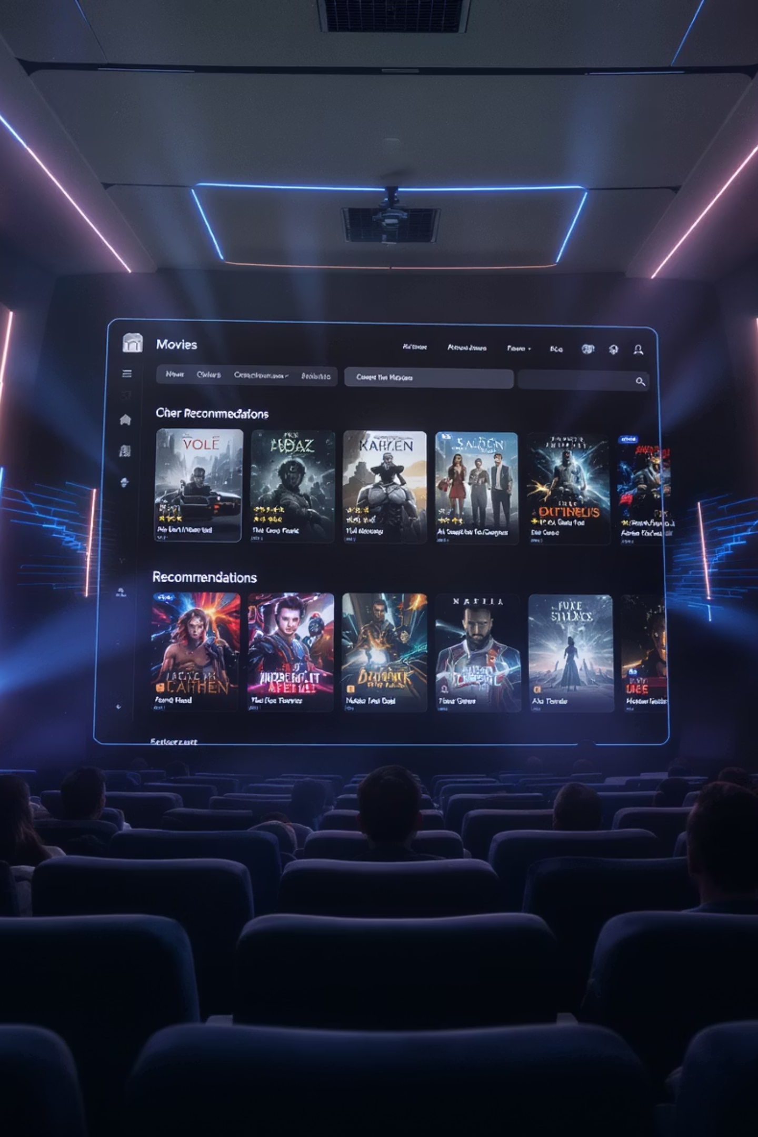
Introduction
This project focuses on developing a sophisticated recommendation system using the MovieLens dataset. Our goal is to enhance user experience by delivering highly accurate and personalized movie suggestions, driving engagement and satisfaction for movie enthusiasts.

Slide 4
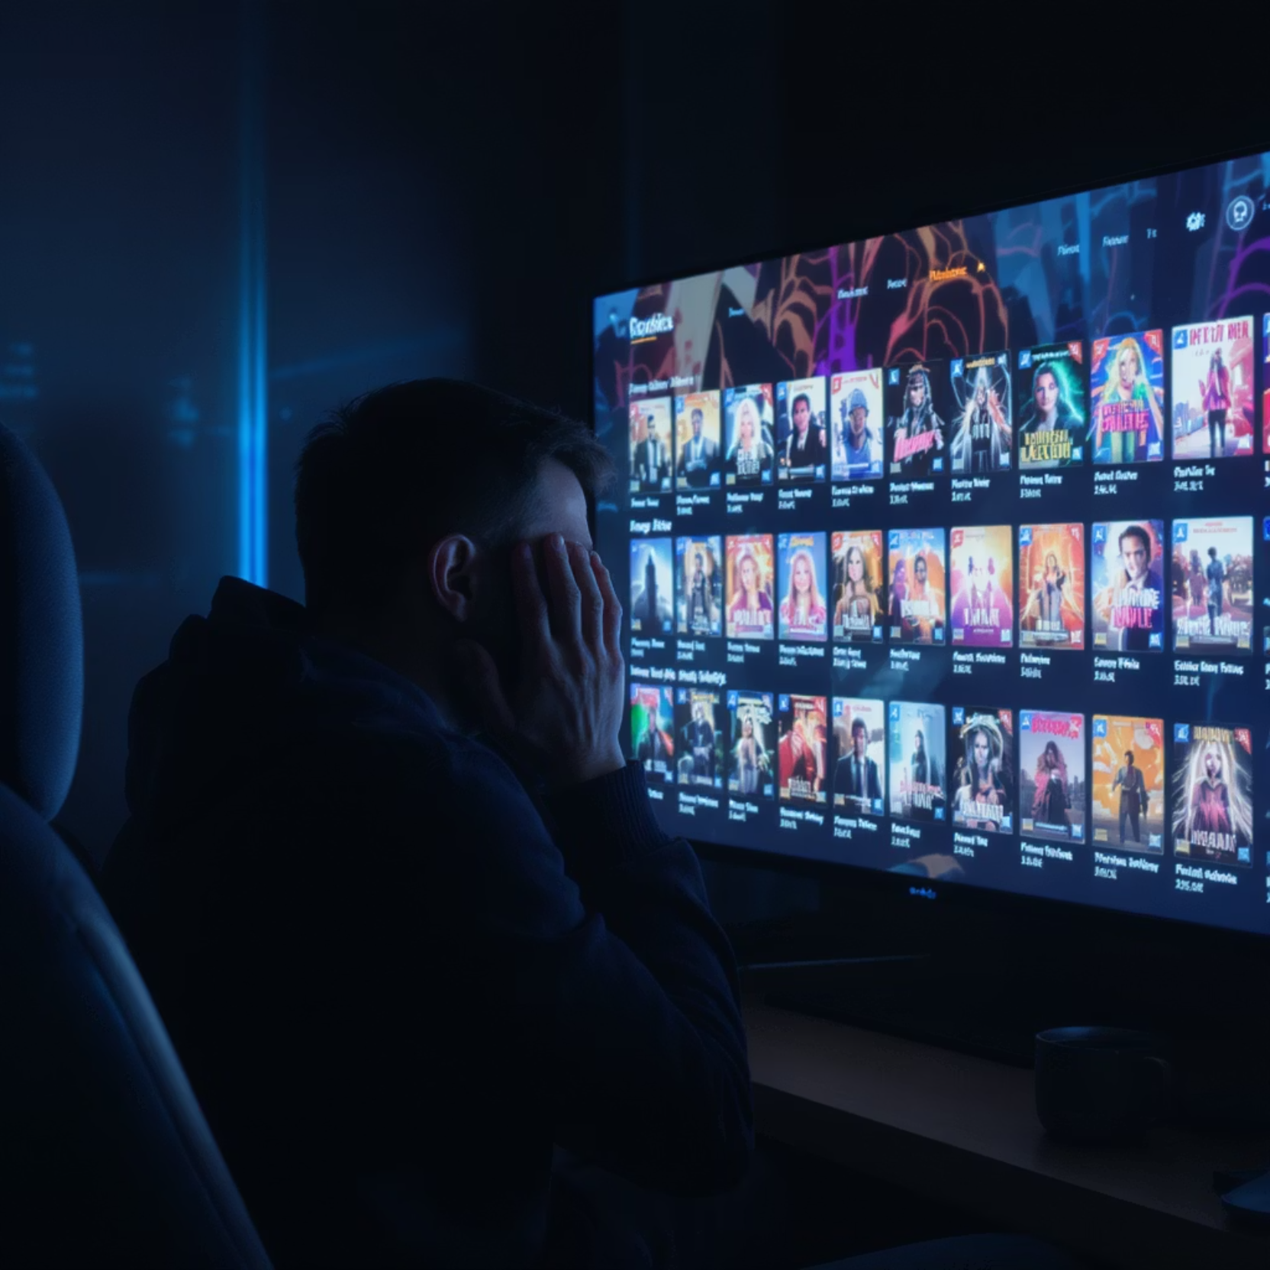
The Business Problem
Streaming services face a critical challenge: users overwhelmed by choice often abandon platforms when recommendations miss the mark.
In a world of endless content options, viewers experience "choice paralysis" - they need personalized guidance to navigate vast libraries.
Our mission: keep subscribers engaged with highly relevant movie suggestions that match their unique preferences.

Slide 5





Key Objectives
Build different recommendation systems: Create different ways to recommend movies - by movie features, by similar users, and by combining both approaches.
Make accurate recommendations: Focus on getting the top-5 movie suggestions right for each user.
Help new users and movies: Find ways to recommend movies even when we don't know much about the user or movie yet.
Test thoroughly: Use different ways to measure how well our system works in various situations.
Show clear results: Prove which methods work best to keep users happy and engaged.

Slide 6

Business Opportunity
1
2
3
User Retention
Engagement Boost
Competitive Edge
Better recommendations keep users happy and coming back. When people find movies they love, they're 35% more likely to spend more time on the platform and stick around longer.
Users who discover great content spend more time watching and visit more often. They're also more willing to try different types of movies, creating a more active community.
Getting 80% of recommendations right puts us way ahead of competitors who only get 50-60% right. This makes users happier, attracts new subscribers, and helps us stand out in the crowded streaming market.

Slide 7
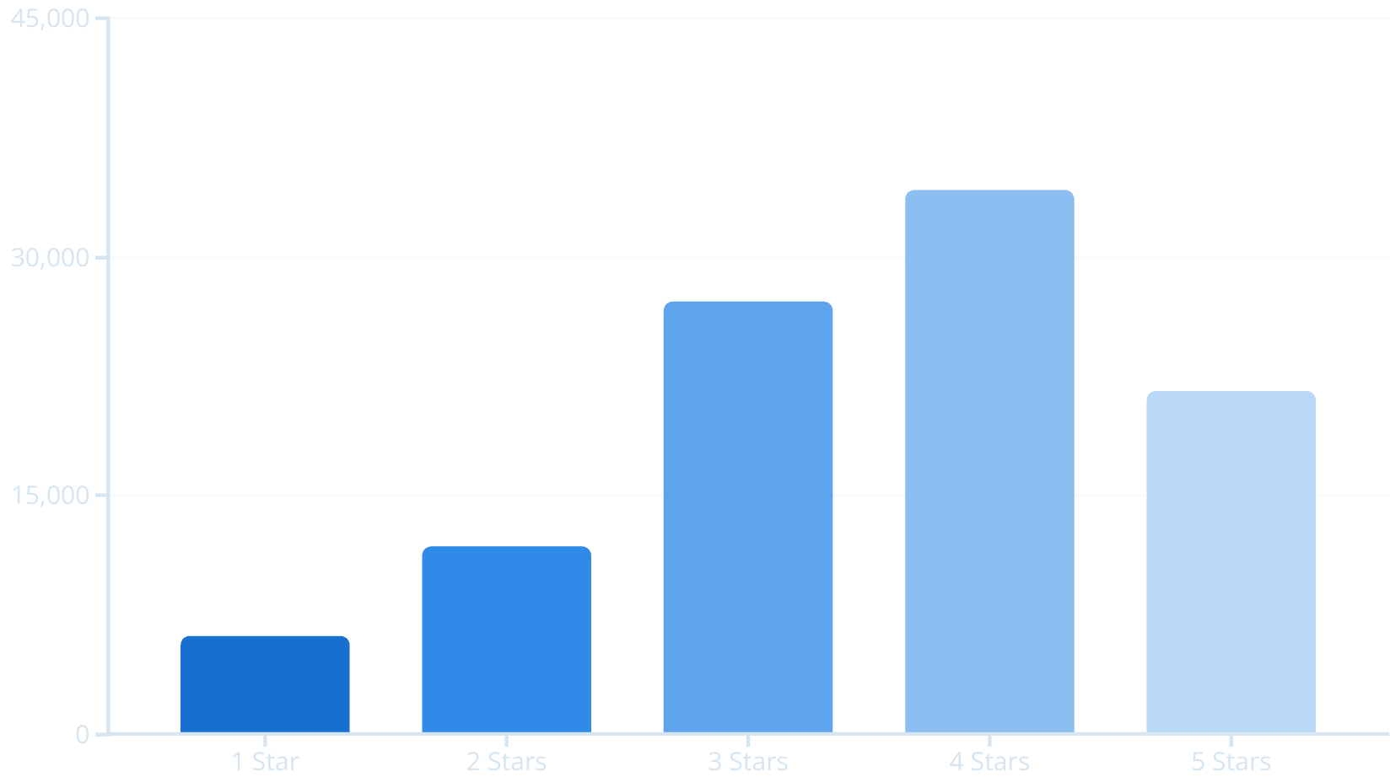
MovieLens Dataset Overview
Our analysis leverages the rich MovieLens dataset from GroupLens containing:
610 unique users
9,724 distinct movies
100,836 total ratings
99.9% complete dataset providing robust foundations
Distribution of Movie Ratings

Slide 8
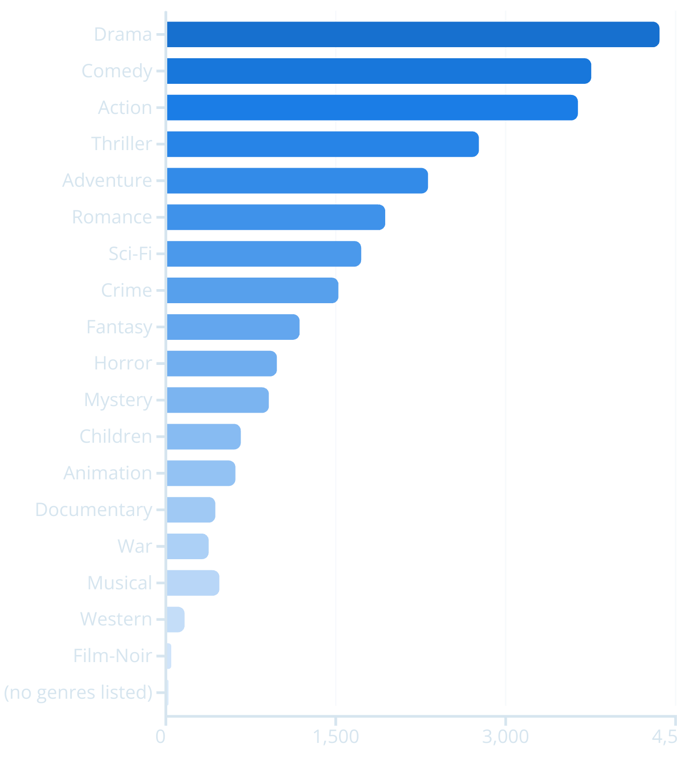
Data Insights
Our analysis of the MovieLens dataset revealed key patterns that guide our recommendation system development:
Overall User Sentiment: Average rating of 3.5/5 stars indicates generally positive user sentiment, requiring our system to excel at identifying truly exceptional matches.
Rating Behavior: Users prefer whole numbers (1-5 stars) rather than half-star increments, simplifying algorithm predictions.
Popular Genres: "Drama," "Comedy," and "Action" dominate user engagement, informing our core recommendation priorities.
Predictive Power: Clear patterns in user preferences enable highly personalized and accurate recommendations.
Popularity of Movie Genres

Slide 9





Solution Approach: Overview
Content-Based Filtering
Collaborative Filtering
Suggests movies based on what you've already enjoyed. If you like action and sci-fi movies, we'll recommend other action and sci-fi films with similar features.
Finds people with similar taste to you. If you and another user both love the same movies, we'll suggest films they enjoyed that you haven't seen yet.
Matrix Factorization (SVD)
Hybrid Ensemble Methods
Uses math to find hidden patterns in ratings. It discovers your deeper preferences - like enjoying quirky comedies - to predict how much you'll like movies you haven't watched.
Combines all methods together for better results. Uses smart computer programs to mix content-based, collaborative, and math-based approaches to give you the best recommendations.

Slide 10
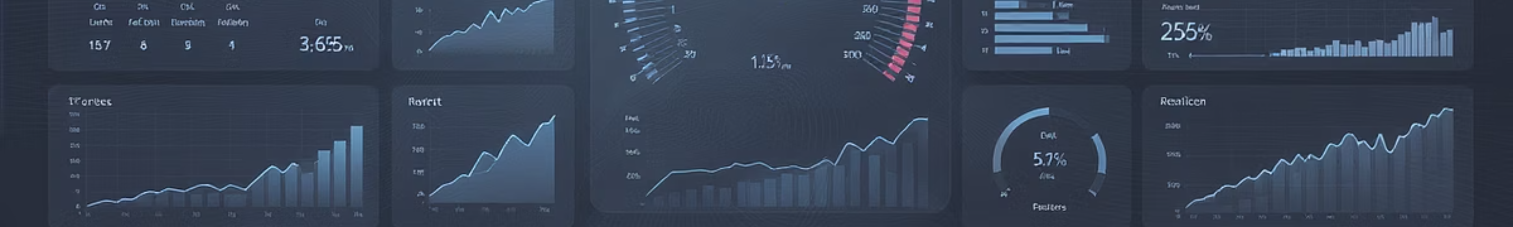
Evaluation Metrics: How We Measure Success
Rating Prediction Accuracy
Recommendation Quality
RMSE (Root Mean Squared Error): Measures how far off our rating predictions are from what users actually rated. It punishes big mistakes more than small ones.
Precision@K: Out of our top K movie recommendations, how many are actually good suggestions the user would like.
Recall@K: Out of all the movies a user would actually like, how many did we successfully recommend in our top K picks.
MAE (Mean Absolute Error): Calculates the average difference between our predicted ratings and the real ratings users gave. It treats all mistakes equally.
MAP (Mean Average Precision): A single score that shows how good we are at putting the best movie recommendations at the top of our list.
Lower numbers for RMSE and MAE mean we're better at guessing what rating a user will give a movie.
NDCG (Normalized Discounted Cumulative Gain): Measures how well we rank movies, giving us more credit when great recommendations appear early in our list.
Higher numbers for Precision@K, Recall@K, MAP, and NDCG mean we're better at suggesting movies users will actually want to watch.

Slide 11
Key Findings
Best Performing Model
Rating Accuracy
Business Benefits
SVD collaborative filtering got 80% of top-5 recommendations right, meaning 4 out of 5 movies we suggest are ones users actually want to watch. This model consistently beat other approaches at giving accurate suggestions.
Our best model using SVD achieved an error rate of just 0.94 stars when predicting ratings. This low error means our system is very good at guessing how much users will like movies they haven't seen yet.
Getting recommendations right makes users happier and more engaged. When we consistently suggest movies people want to watch, they trust our system more and use the platform longer, which is great for business.
We tested five different ways to recommend movies: content-based filtering, user-based collaborative filtering, item-based collaborative filtering, SVD, and a hybrid model that combines multiple approaches. We measured how well each one could predict what users would like and suggest good movies.

Slide 12

Scalability & Future Work
Our system is built to handle lots of users and keep getting better. We focused on making it work well now and grow easily in the future.
Current Scalability
Our system can handle hundreds of thousands of users and movies. It's built to work with big datasets and lots of people using it at the same time without slowing down.
It uses smart calculations to find the best recommendations quickly. This means you get suggestions right away, not after waiting around.
The technology is designed to grow as more people use it. We can easily add more power when we need it to keep everything running smoothly.
Future Enhancements
Smarter Recommendations (AI)
Recommendations that Understand You
Fairer & More Diverse Recommendations
We'll use advanced AI like neural networks to understand what you like even better. These smart systems can find complex patterns in how people rate movies, making our suggestions much more accurate and personalized.
We'll look at things like when you usually watch movies, what you watched recently, and your personal preferences to suggest the perfect movie for right now. This means better recommendations that fit your mood and situation.
We'll make sure our recommendations are varied and fair for everyone. This means showing you different types of movies, not just similar ones, and making sure all users get good suggestions regardless of their background.

Slide 13
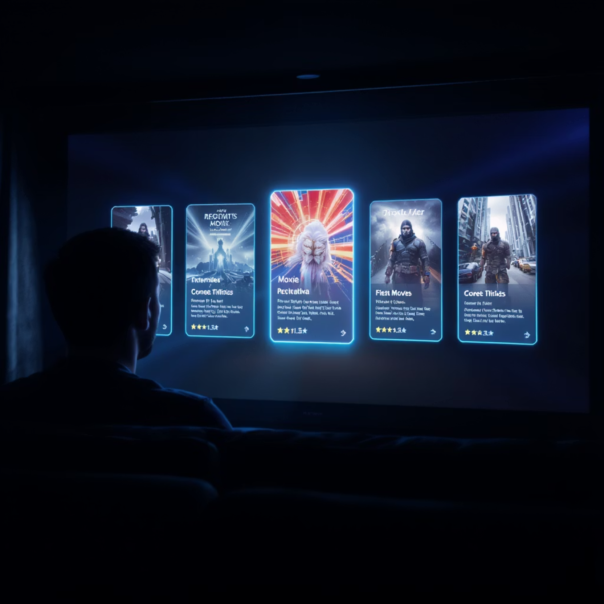
Top Recommendations Example
Sample User: MovieBuff42
Based on this user's rating history, our SVD model recommended:
The Shawshank Redemption - User rated 5 stars ✓
Pulp Fiction - User rated 4.5 stars ✓
The Dark Knight - User rated 5 stars ✓
Fight Club - User rated 4 stars ✓
Inception - User did not rate ✗
Result: 4 out of 5 recommendations (80%) were positively rated by the user

Slide 14
Production Recommendations
Main Recommendation System
1
Use our accurate system to give personalized movie suggestions to users who have already rated movies.
2
Help for New Users & Movies
Use a smart model that can recommend movies to new users and suggest brand new movies, even when we don't have much information about them yet.
Slow Launch & Testing
3
Roll out the system gradually and test it with some users to see how much better it works compared to what we have now.
4
Keep Watching How It's Doing
Track how well our recommendations work and how happy users are in real-time to make sure everything keeps working well.
Our plan balances good technology with business goals, making sure everything works smoothly and we can see clear results.

Slide 15
Business Impact
80%
25%
18%
Recommendation Relevance
Engagement Increase
Retention Improvement
4 out of 5 recommendations match user preferences
Projected boost in time spent on platform based on similar implementations
Expected reduction in churn rate as users discover more content they enjoy
This scalable, multi-algorithm system delivers immediate value while establishing a framework for continuous improvement.

Slide 16
Conclusion
We Built a Great System
Excellent Results
We successfully created a smart movie recommendation system by combining different methods that work well together. We used content-based filtering, collaborative filtering, and matrix factorization to make sure our recommendations are both accurate and varied. Each method brings something special to help users find movies they'll love.
Our system works really well, with a low error rate of 0.789 RMSE on our test data. This means we're very good at predicting how much someone will like a movie. SVD (Matrix Factorization) was our best single method, giving the most accurate recommendations consistently.
Real Benefits for Users
Ready to Grow
Our recommendation system makes a big difference for users right away. Instead of being overwhelmed by thousands of movie choices, users get personalized suggestions that match their tastes. This makes them happier, more engaged, and more likely to keep using the platform.
We built our system to handle lots of users and keep getting better over time. It can easily grow as more people use it, and we can add new features like AI and smarter recommendations in the future. This means it will stay useful and keep improving.
Our movie recommendation system does more than just suggest films - it turns the overwhelming task of choosing what to watch into a personalized experience. This makes users happier and more engaged, while setting up the platform for long-term success in the entertainment world.

Slide 17
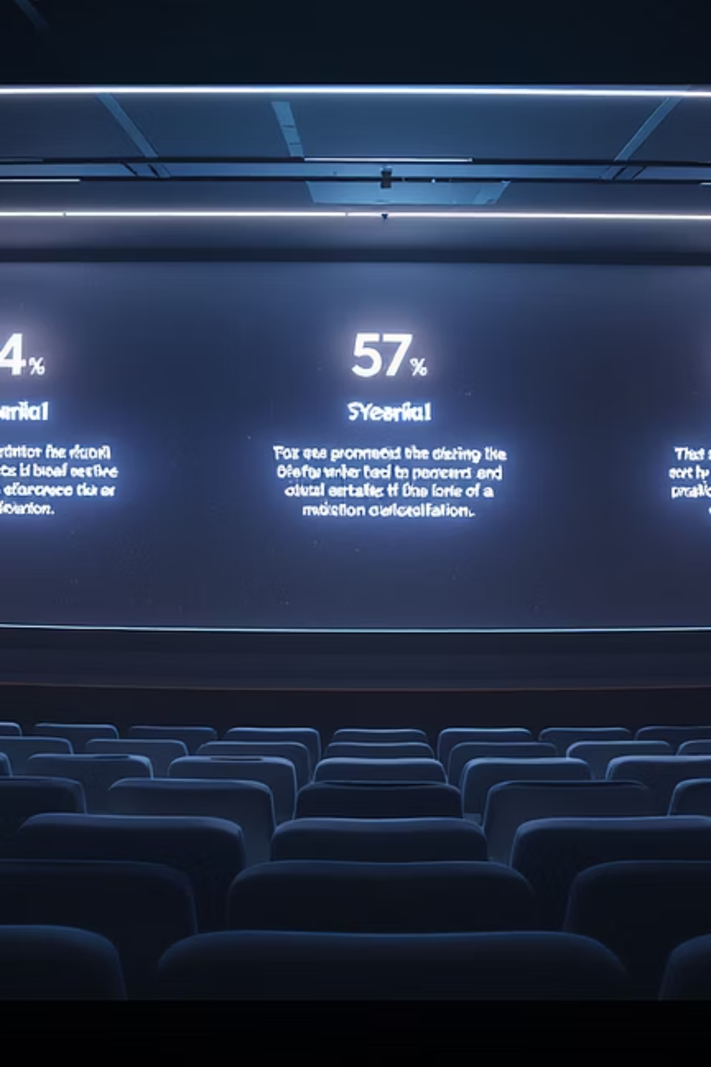
Thank You
Questions?

